Slide 1
TISS Presentation
Presentation on Visual Basic

Slide 2
Visual Basic Presentation
Visual Basic:- It is an object oriented programming language for creating application that runs under any one of the Microsoft windows system.

Slide 3
Visual Basic Presentation
Object Related Concept:- In addition to the event and event procedures we have to understand the following terms:
Forms
Controls
Objects
Properties
Methods

Slide 4
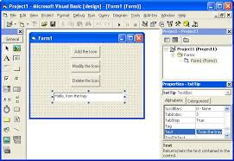
Visual Basic Presentation

Slide 5
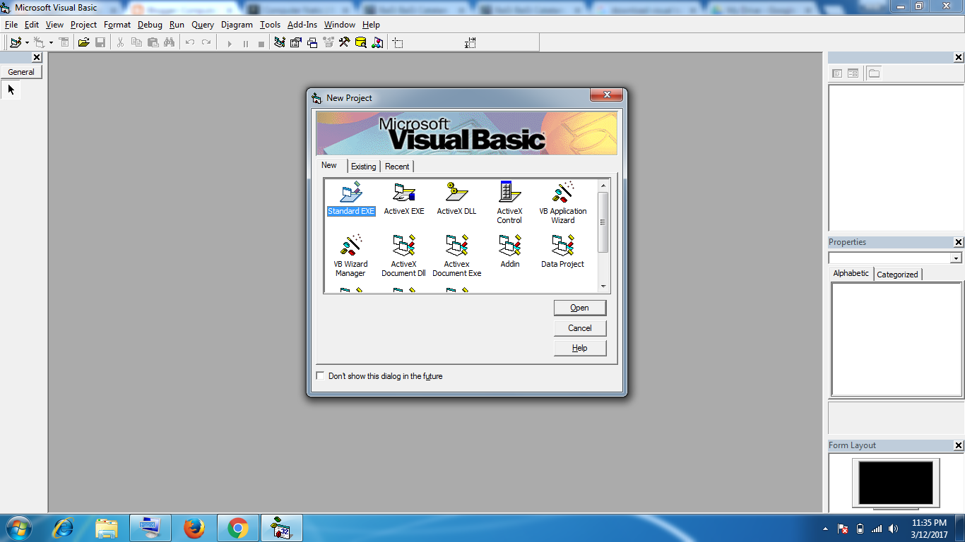
Visual Basic Presentation
Visual Basic Interface:-

Slide 6
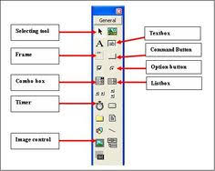
Visual Basic Presentation
Visual Basic Interface:-

Slide 7
Visual Basic Presentation
Visual Basic Environment:-
There are Different menu bars that are present in Visual Basic. They are as follows:
Title Bar, Menu Bar
Tool Bar
Form Design and Project Container Window
Toolbox
Properties Window
Project Window
Code Editor Window
Form Layout Window
Immediate Window

Slide 8
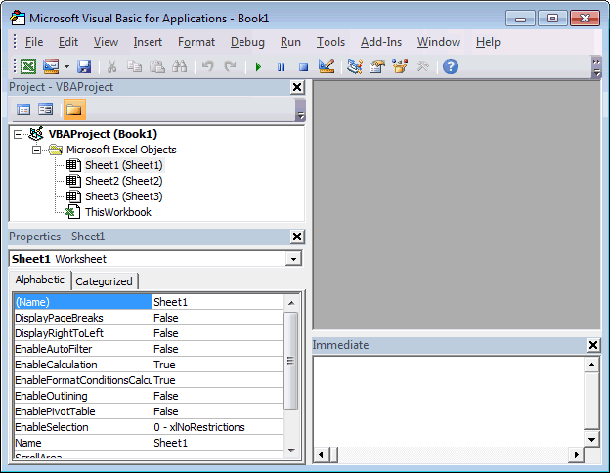
Visual Basic Presentation
Opening an existing project in Visual Basic Environment:-

Slide 9
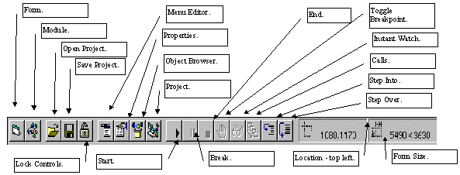
Visual Basic Presentation
Toolbar in Visual Basic:-

Slide 10
Visual Basic Presentation
Constants in Visual Basic:-
There are two types of constant in Visual Basic.
1. Numeric Constant
2. String Constant

Slide 11
Visual Basic Presentation
Variables in Visual Basic:-
There are two types of constant in Visual Basic.
1. Numeric Constant
2. String Constant

Slide 12
Visual Basic Presentation
User Defined Data Types in Visual Basic:-
Type data type name
Member name 1 as data type 1
Member name 2 as data type 2

Slide 13
Visual Basic Presentation
Operators and Expression:- Special symbols are called arithmetic operators. They are Addition, Subtraction, Multiplication, Division and Exponentiation.
The Standard arithmetic operator are as follows:
Addition +
Subtraction -
Multiplication *
Division /
Exponentiation ^

Slide 14
Visual Basic Presentation
Hierarchy of Operation:- The hierarchy of operation in visual Basic is as follows:
Exponentiation
Multiplication and Division
Integer Division
Integer Remainder
Addition and Subtraction

Slide 15
Visual Basic Presentation
Branching and Looping:- Looping is a technique that executes the program more than one times.

Slide 16
Visual Basic Presentation
Relational Operator and Logical Expression:- In order to carry out branching operation in VB, we must be able to express the conditions of equality and inequality. To do so, we make the use of following relational operator:
Equal =
Not Equal <>
Less than <
Less than or equal to <=
Greater than >
Greater than or equal to >=

Slide 17
Visual Basic Presentation
Logical Operators:- In addition to the relational operators, VB contains several logical operators. They are And, Or, Xor, Not, Eqv(equivalent) and Imp(implies).

Slide 18
Visual Basic Presentation
Logical Operators:-
Logical Not Not
Logical And And
Logical Or Or
Logical Xor Xor
Logical Eqv Eqv
Logical Imp Imp

Slide 19
Visual Basic Presentation
Branching with the If-Then Block:-
An If-then block is used to execute a single statement or a block of statements on a conditional basis. There are two different forms. The Simpliest form is as follows
If logical expression Then executable statement

Slide 20
Visual Basic Presentation
Branching with the If-Then-Else Block:-
An If-then-else block permits one of two different groups of executable statements to be executed , depending on the outcome of a logical test.
If logical expression Then
Executable statements
Else
Executable statements
End if

Slide 21
Visual Basic Presentation
Select Case:- One way to select a block of statements from several competing blocks is to use a series of If-Then-Else or If-Then-ElseIf-Else blocks. This can be tedious how ever if the number of competing blocks is moderately large.

Slide 22
Visual Basic Presentation
Select Case:-
Select Case expression
Case value 1
Executable Statement
Case value 2
Executable Statement
……
Case Else
Executable Statement
End Select

Slide 23
Visual Basic Presentation
Looping with For-Next:-
Select Case expression
Case value 1
Executable Statement
Case value 2
Executable Statement
……
Case Else
Executable Statement
End Select

Slide 24
Visual Basic Presentation
Looping with Do:-
Select Case expression
Case value 1
Executable Statement
Case value 2
Executable Statement
……
Case Else
Executable Statement
End Select

Slide 25
Thank You

